Slide 1
Multilayer Perceptron Training Acceleration on Fashion-MNIST dataset
Performance Analysis and Optimization Project
Blîndu Andrei-Samuel, 411-ACES
1

Slide 2
Table of contents
01
02
03
05
06
07
04
Introduction
SOTA
F-MNIST
Naive
What is a MLP and how does it work
Methodology proposals & Acceleration approaches
Description and motivation behind choice
Single threaded implementation
08
Limits
Optimizations
References
CPU, GPU & memory specs => estimated theoretical limits
Compiler flags, OpenMP, AVX2, OpenCL
Results & Conclusions
2

Slide 3
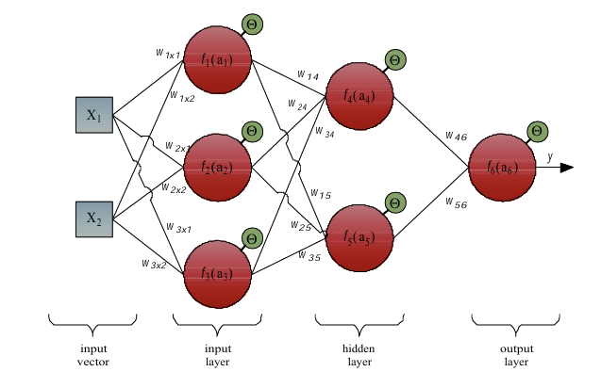
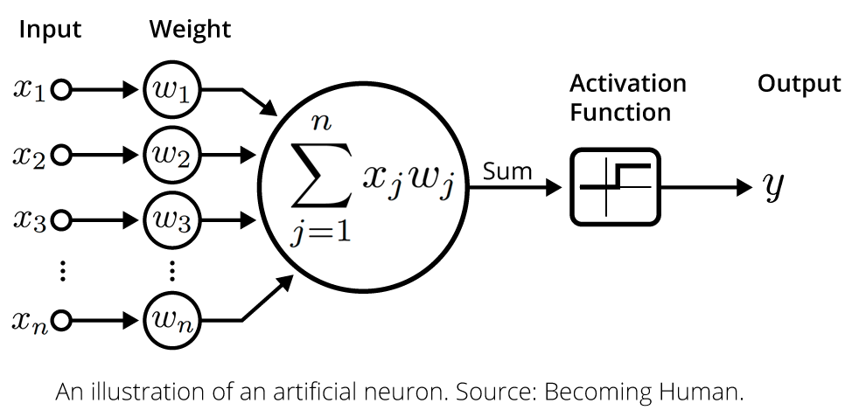
Introduction
Machine learning (ML)= generalizing a concept (inference) through a learning paradigm
Supervised learning = learning paradigm, map input to output using labeled training set
Multilayer Perceptron (MLP) = fundamental supervised neural network learning architecture
Source: [11]
3

Slide 4
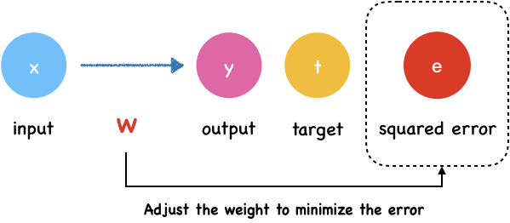
Introduction (cont.)
Feed-forward propagation
Backpropagation
Source: https://yogayu.github.io/DeepLearningCourse/03/ForwardPropagation.html
Source: https://yogayu.github.io/DeepLearningCourse/04/GradientDescent
Source: https://medium.com/aimonks/unraveling-the-multilayer-perceptron-a-journey-into-neural-network-excellence-db64ea4bc6c5
Complex applications => ↑ hidden layers, ↑ neurons / layer, ↑ training data, ↑ training epochs
MLP trains slow…
4

Slide 5
State-of-the-Art
Change the training algorithm altogether
[2] Acceleration of backpropagation with selective momentum term
- Introduces a Selective Momentum Term (SMT) approach that selectively applies momentum to certain weights based on Pearson or Spearman correlation coefficients, rather than applying momentum to all weights uniformly
[4] An accelerated learning algorithm for MLP layer by layer
- Proposes a completely new Optimization Layer by Layer (OLL) learning algorithm that optimizes network weights layer by layer through linearization of nonlinear processing elements, rather than using traditional backpropagation
[5] An accelerated learning algorithm for multilayer perceptron networks
- Introduces Adaptive Back Propagation (ABP) algorithm that modifies the weight update rule by making the learning rate a specific function of the error and error gradient norm, inspired by variable structure systems theory

Slide 6
State-of-the-Art
Accelerate Standard Backpropagation
[3] Multicore CPU and GPU under MATLAB Environment
- Accelerates standard backpropagation using parallel processing on multicore Intel i7 processors and GeForce 610M GPU
[6] FPGA acceleration on a multi-layer perceptron neural network for digit recognition
[7] Parallelizing Backpropagation Neural Network Using MapReduce and Cascading Model
[8] Accelerating Neural Network Training Process on MultiCore Machine Using OpenMP
[9] OpenCL optimization for FPGA deep learning application
-Optimizes standard deep learning algorithms on FPGA using OpenCL programming model with 8-40x performance improvements
[10] Parallel Backpropagation Neural Network Training using Graphics Processing Unit
- Discusses GPU parallelization with CUDA, claiming up to 496x speedup
[11] Master’s thesis: Hardware accelerated neural networks
- Discusses GPU-based parallelization of standard neural network training using CUDA architecture
5

Slide 7
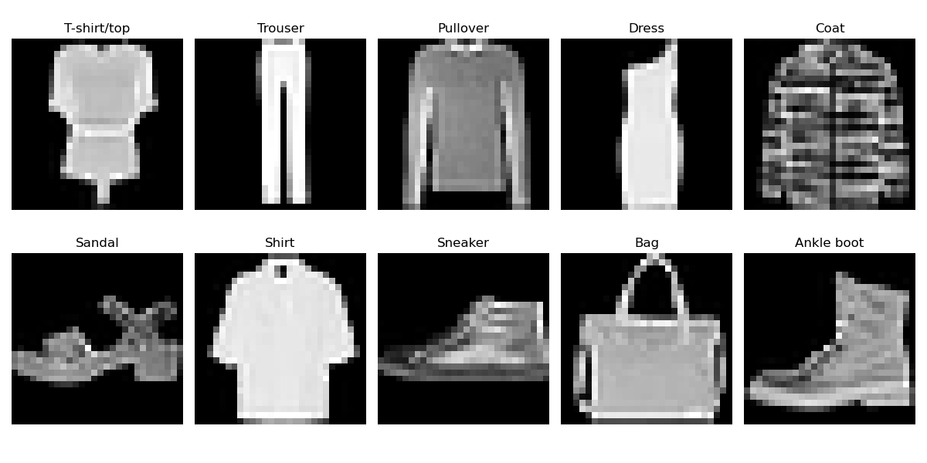
Fashion-MNIST dataset
Custom MLP Implementation: Developed a single-threaded C++ MLP implementation from scratch
Fashion-MNIST Dataset Selection: F-MNIST over traditional MNIST as the benchmark dataset because MNIST has become too simple (with models achieving 99.7% accuracy)
Architecture and Performance: Implemented a four-layer network (784 input → 128 → 64 → 10 neurons) using ReLU and softmax activations, achieving 87% accuracy when trained on 5,000 samples (predicts on 500) with a learning rate of 0.01
6

Slide 8
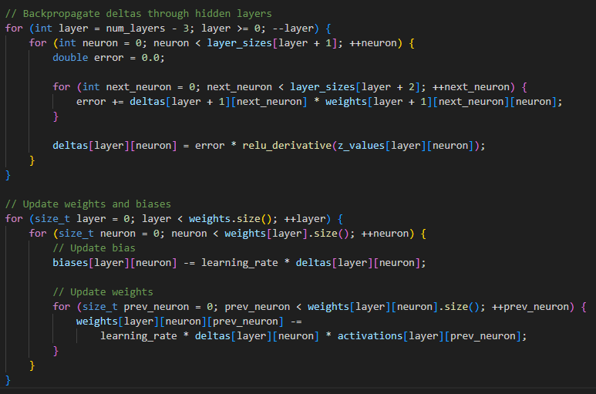
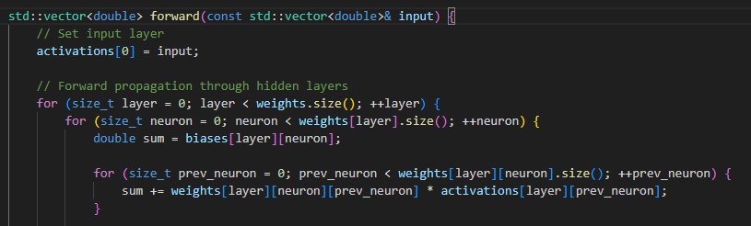
Naive implementation
Single-threaded, -O0, completely unoptimized
5000 images x 50 epochs
Load data
5000 train, 500 test
Init MLP
784->128->64->10
Forward pass
Backpropagation
Update weights
Test & Evaluate
Accuracy
Start chronometer
Stop chronometer
Intel Core i5-9300H CPU @ 2.40GHz required 937.104 seconds (approximately 15.6 minutes), averaging 18.742 seconds per epoch
7

Slide 9
Theoretical performance limits
CPU
Intel Core i5-9300H CPU @ 2.4 GHz (up to 4.1 GHz overclocked), 4 cores, 8 threads
Cache: L1: 4x32KB instruction + 4x32KB data, L2: 4x256KB, L3: 8MB shared
AVX2
GPU
NVIDIA GeForce GTX 1650 @ 1.485 GHz (up to 1.665 GHz overclocked), 896 cores
GPU memory: 4GB GDDR5, 128 GB/s bandwidth
Architecture: {784, 128, 64, 10}
Training Configuration: 5,000 samples × 50 epochs = 250,000 total training iterations
Forward pass: ~109,588 ops
Backpropagation: ~118,420 ops
}
228,008 ops x 250,000 samples = 57.002 GFLOPS
CPU 8-Thread with AVX2: 8 threads × 4.1 GHz × 8 FMA operations = 262.4 GFLOPS peak => 57.002 / 262.4 = 0.217 seconds.
GPU Implementation: 896 cores × 1.665 GHz × 2 ops/cycle = 2982 GFLOPS peak; Input data: 5,000 × 784 × 4 bytes = 15.68 MB, model weights: ~109,386 parameters × 4 bytes = 0.44 MB => total transfer: ~16.12 MB × 2 (to/from GPU) = 32.24 MB @ PCIe 3.0 x16 (12 GB/s): 32.24 MB ÷ 12 GB/s = 0.0027 seconds => 57.002 / 2982 + 0.0027 = 0.0218 seconds.
8

Slide 10
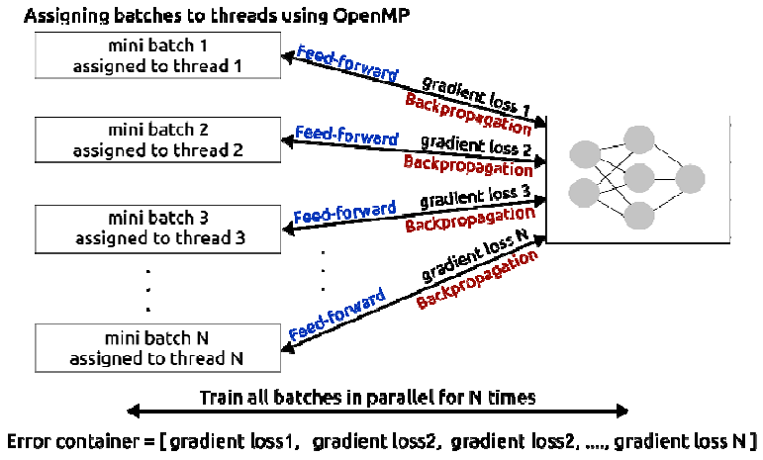
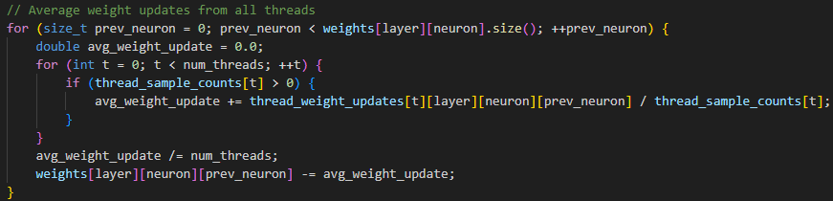
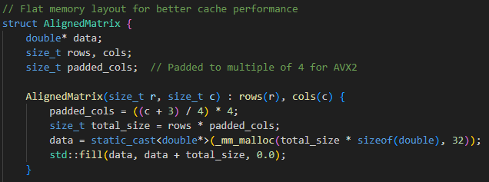
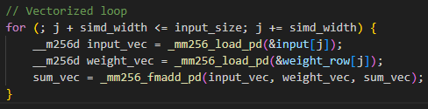
CPU Optimized
Using –O3 compilation flag: 928.242 seconds (15.5 minutes), 18.565 seconds per epoch
OpenMP: 8 independent threads, mini-batch training inspired by [8]
Weight adjustments are averaged across all batches, then applied globally.
=> 86.529 seconds (1.4 minutes), 1.731 seconds per epoch
3. AVX2:
std::vector<std::vector<std::vector<std::vector<double>>>> …
AVX2 intrinsics – FMA, vectorized memory access, avx relu
=> 30.322 seconds (0.5 minutes) , 0.606 seconds per epoch
9

Slide 11
GPU Optimized
OpenCL : 5 specialized OpenCL kernels that collectively orchestrate the complete training pipeline.
forward_pass kernel: Performs dense layer matrix multiplication using 1D work-item arrangement. Each work-item computes a single output activation (batch_idx * output_size + neuron_idx), enabling parallel computation across all batch samples and neurons simultaneously.
relu_activation kernel: Applies elementwise ReLU transformations using simple 1D indexing.
softmax_activation kernel: Implements numerically stable softmax using work-groups with local memory reductions to compute maximum and sum values efficiently, preventing numerical overflow.
compute_deltas kernel: Handles backpropagation using 2D NDRange organization (batch_size × layer_size) with direct work-item mapping, efficiently computing different delta calculations for output layers versus hidden layers with ReLU derivatives.
update_weights kernel: Performs gradient accumulation and parameter updates using 2D work-item arrangement (output × input neurons), with each work-item computing one weight gradient through batch accumulation and applying learning rate updates in-place.
=> 4.207 seconds, 0.084 seconds per epoch !
10

Slide 12
Results & Conclusions
Paper & Platform | Train time | Baseline | Speedup vs Baseline
[3] Multicore CPU (8-Core) | 47.041-117.628 s | MATLAB single-core implementation | x1.12-4.16
[3] GPU (48 cores) - MATLAB | 386-378 s | MATLAB single-core implementation | x304.6
[6] FPGA vs MATLAB | 1.55 μs per image | MATLAB software implementation | x40.4-127.2
[8] OpenMP (10 threads) | 28-35ms | Existing optimized mini-batch training approach | x1.25
[8] OpenMP (12 threads) | 18-29ms | Existing optimized mini-batch training approach | x1.33-1.58
[9] OpenCL FPGA | 9.76ms | Intel Xeon 2.20GHz with -O3 & 16 threads | x9.7
[9] OpenCL vs Xilinx baseline | 9.76ms | Intel Xeon 2.20GHz with -O3 & 16 threads | x8-40
[10] Single GPU CUDA | - | CUBLAS optimized matrix operations | x11.99
[10] Multiple GPUs CUDA | - | CUBLAS optimized matrix operations | x51.33
[10] GPU - Cancer dataset | - | CUBLAS optimized matrix operations | x46
[10] GPU - Mushroom dataset | - | CUBLAS optimized matrix operations | x63
[10] GPU - Multiple Networks | - | CUBLAS optimized matrix operations | x496
[11] Tesla C2050 GPU | 167s (265 epochs) | FANN (Fast Artificial Neural Network Library) | x5.47
 | Train time (s) | Train time / epoch (s) | Predict accuracy | Speedup
Naive | 937.104 | 18.742 | 87% | x1
O3 | 928.242 | 18.565 | 86.5% | x1.009
OpenMP | 86.529 | 1.731 | 85.6% | x10.829
AVX2 | 30.322 | 0.606 | 85.8% | x30.905
OpenCL | 4.207 | 0.084 | 86.4% | x222.748
*Theoretical CPU | *0.217 | *0.004 | - | *x4318
*Theoretical GPU | *0.022 | *0.0004 | - | *x42595
Comparisons with SOTA may be deceiving, but we got good performance results nevertheless.
11

Slide 13
References
Public GitHub repo: https://github.com/Blinduzzi/pao-inference-mlp
Project documentation: https://github.com/Blinduzzi/pao-inference-mlp/blob/main/docs/PAO_MLP_F-MNIST_Blindu_AndreiSamuel_411-ACES.pdf
SOTA: https://github.com/Blinduzzi/pao-inference-mlp/tree/main/docs/sota
Fashion-MNIST dataset: https://github.com/zalandoresearch/fashion-mnist
Intel AVX2 Intrinsics: https://www.intel.com/content/www/us/en/docs/intrinsics-guide/index.html
OpenCL Specification: https://www.khronos.org/opencl/
12

Slide 14
Thanks!
Do you have any questions?
Blîndu Andrei-Samuel, 411-ACES
13

